Slide 1

Distance Measures for Time Series

Slide 2
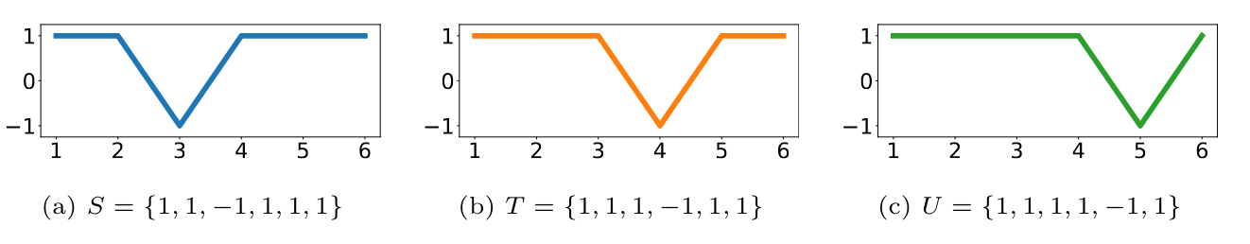
Similarity assessment is foundational for data science
Underpins
Classification
Regression
Clustering
Anomaly & outlier detection
Sequence alignment
Recommender Systems
Feature extraction
Information retrieval
2

Slide 3
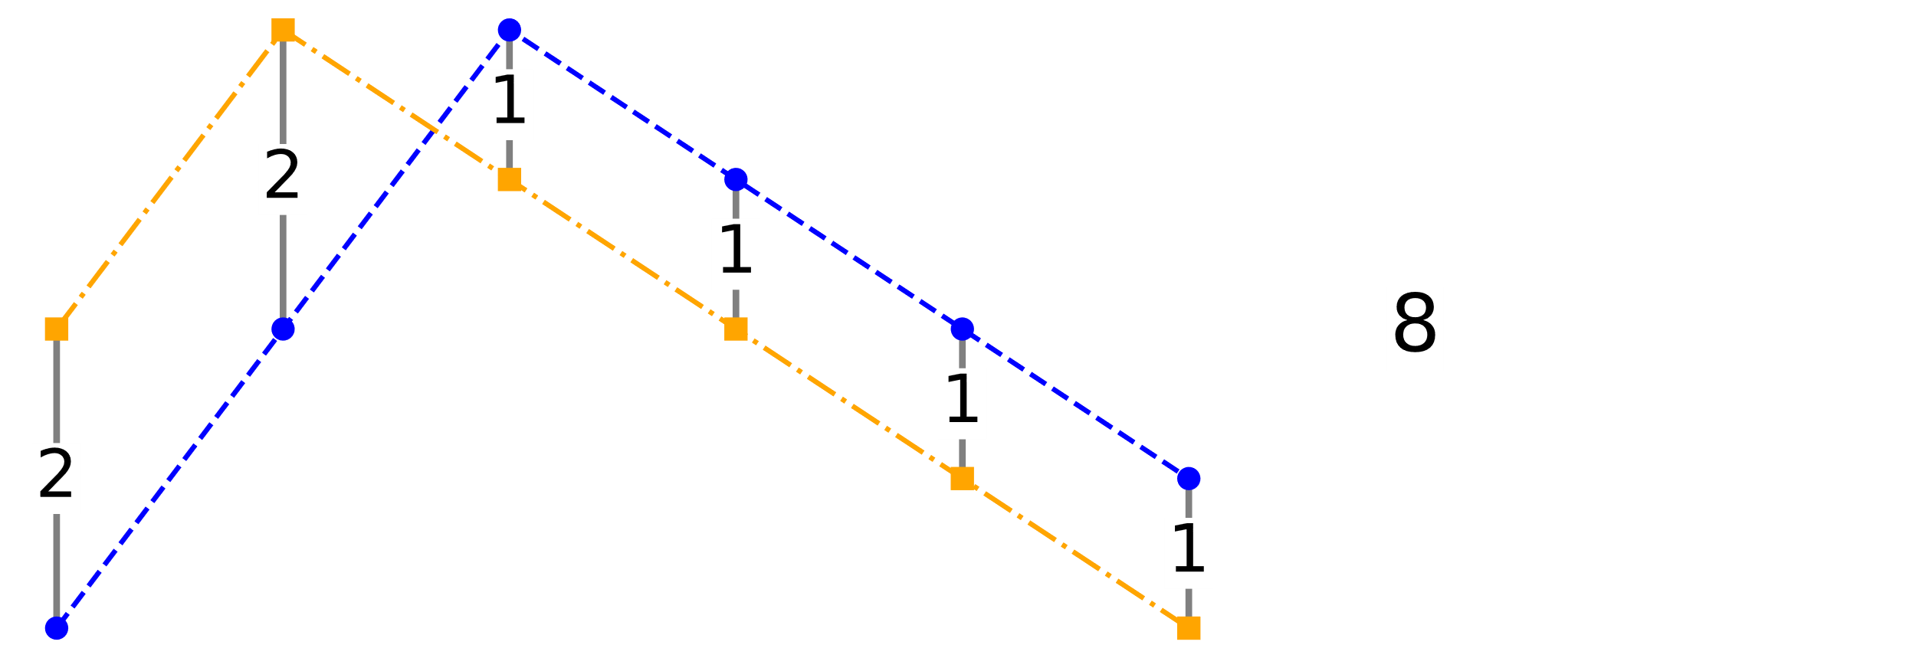
Time series distance measures
Assess similarity in terms of distance between series
Direct Alignment sums differences between points at same time step

Slide 4
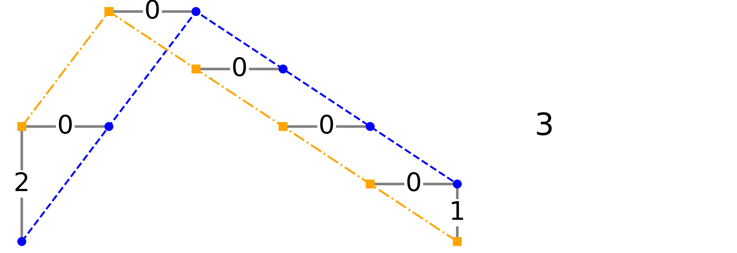
Time series distance measures
Assess similarity in terms of distance between series
Direct Alignment sums differences between points at same time step
Dynamic Time Warping allows alignments across time steps

Slide 5
Dynamic Time Warping (DTW)
Popular distance measure for time series
First points are aligned
Last points are aligned
Successive alignments advance by at most one time step along each series
Distance = minimum cost path that satisfies these constraints

Slide 6
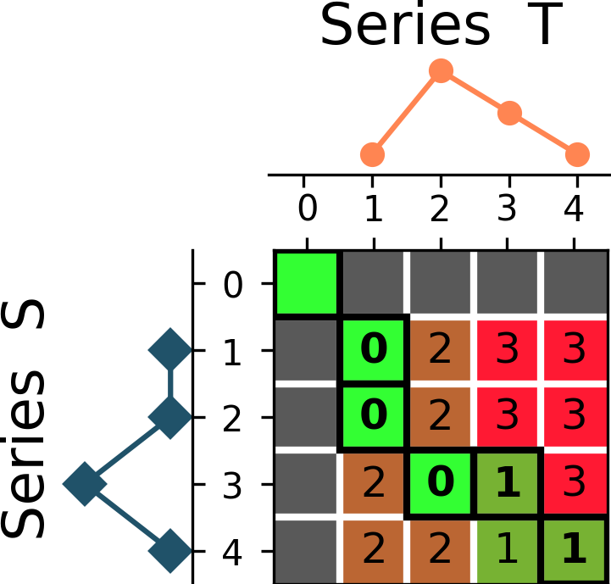
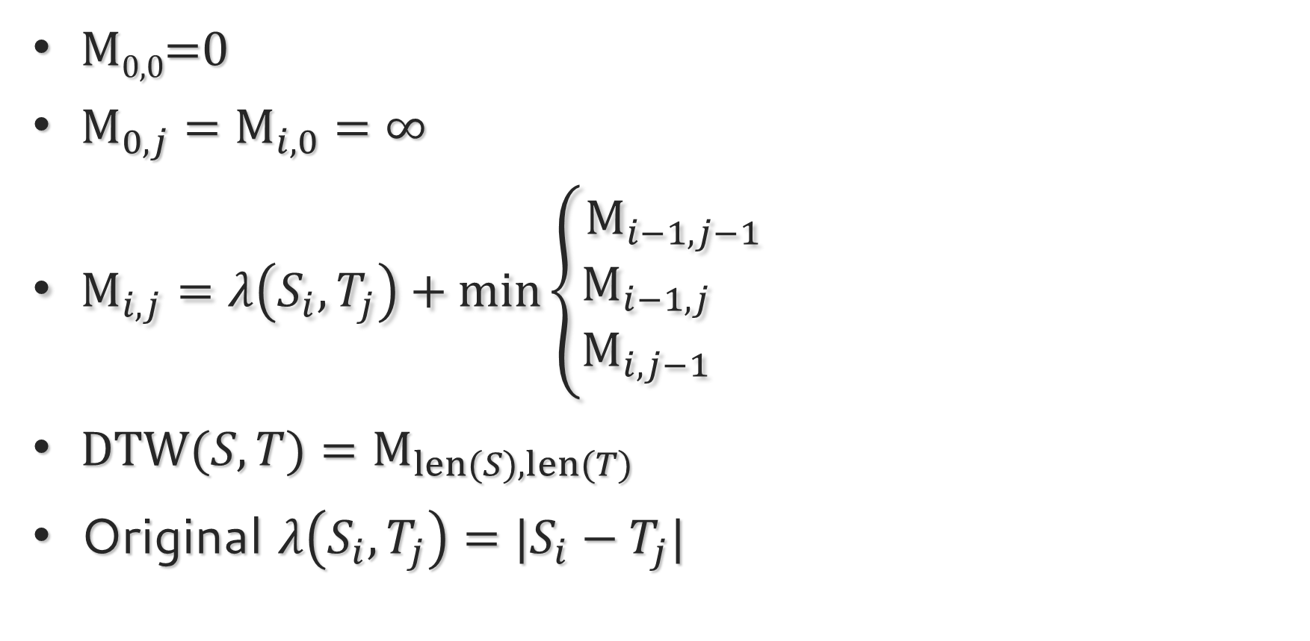

Dynamic programming calculates DTW efficiently
_{S=[0,0,2,0]}
_{T=[0,2,1,0]}
M_{0,0}=0
${\text{M}}_{0,j}={\text{M}}_{i,0}=∞$
${\text{M}}_{i,j}=λ\left(S_{i},T_{j}\right)+\text{min}\left\{\begin{aligned}{\text{M}}_{i−1,j−1} \\ {\text{M}}_{i−1,j} \\ {\text{M}}_{i,j−1} \end{aligned}\right.$
$\text{DTW}(S,T)=M_{len(S),len(T) }$
Original $λ\left(S_{i},T_{j}\right)=|S_{i}−T_{j}|$

Slide 7
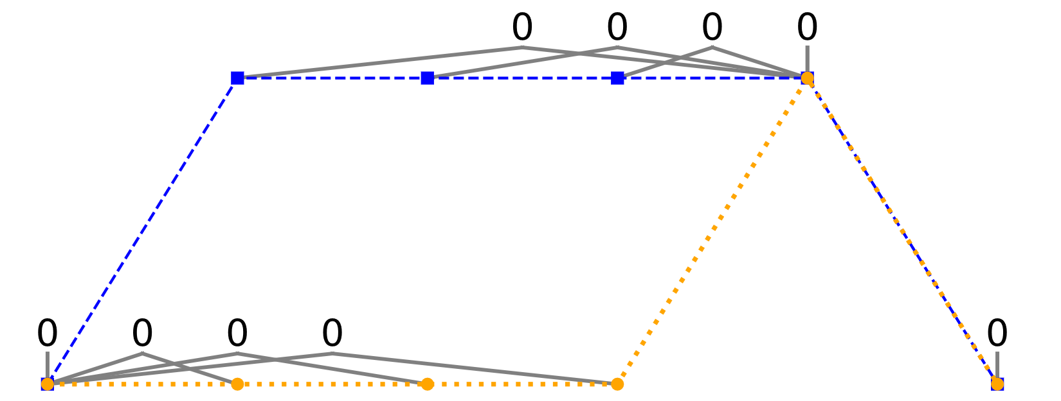
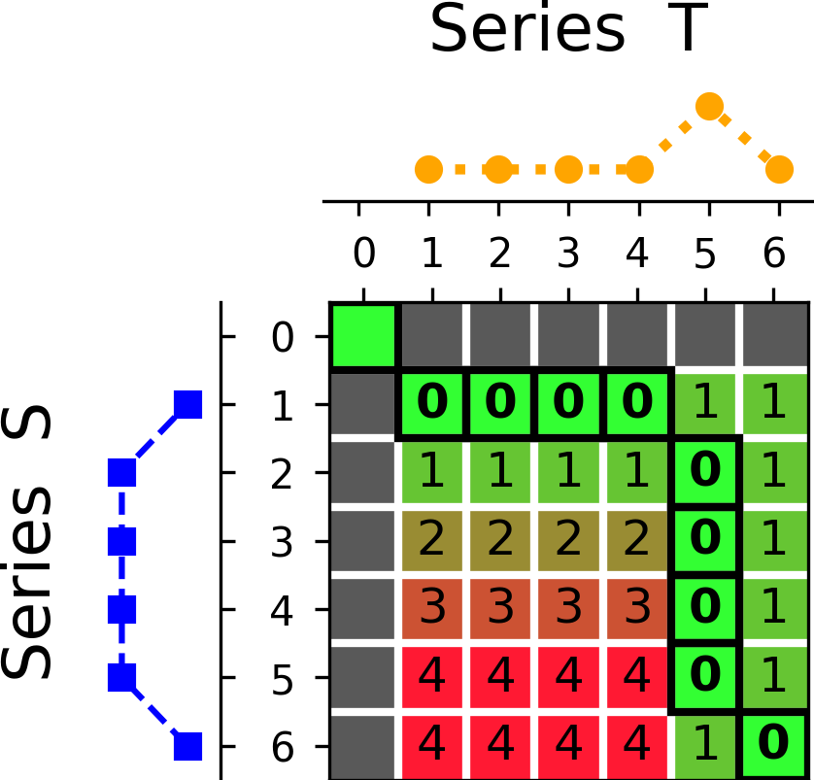
DTW’s warping can be too permissive
DTW = 0

Slide 8
Windowing seeks to control this
Adds further constraint: points cannot be aligned if separated by more than WINDOW time steps
Distance is path with minimum cost that obeys constraints

Slide 9
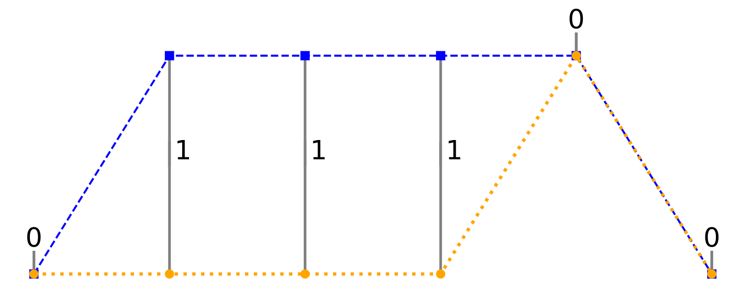
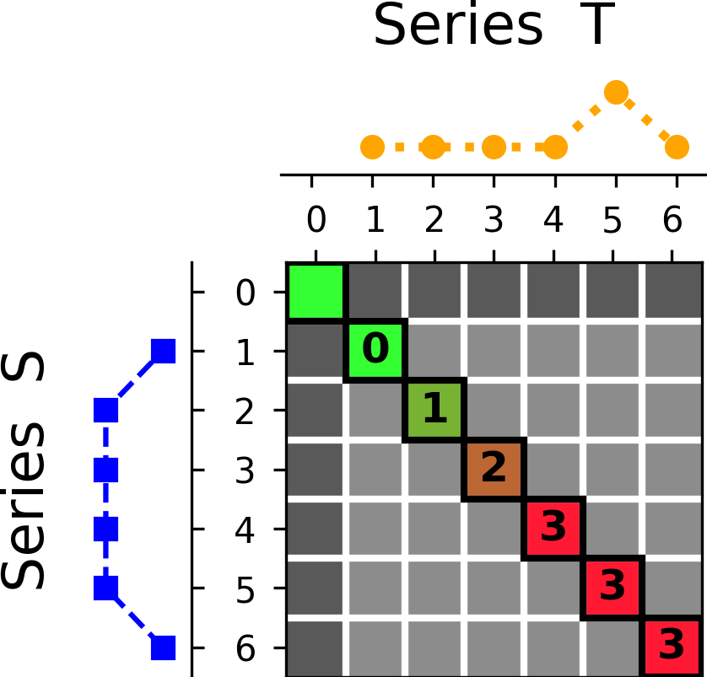
Windowing seeks to control this
Window=0
DTW = 3

Slide 10
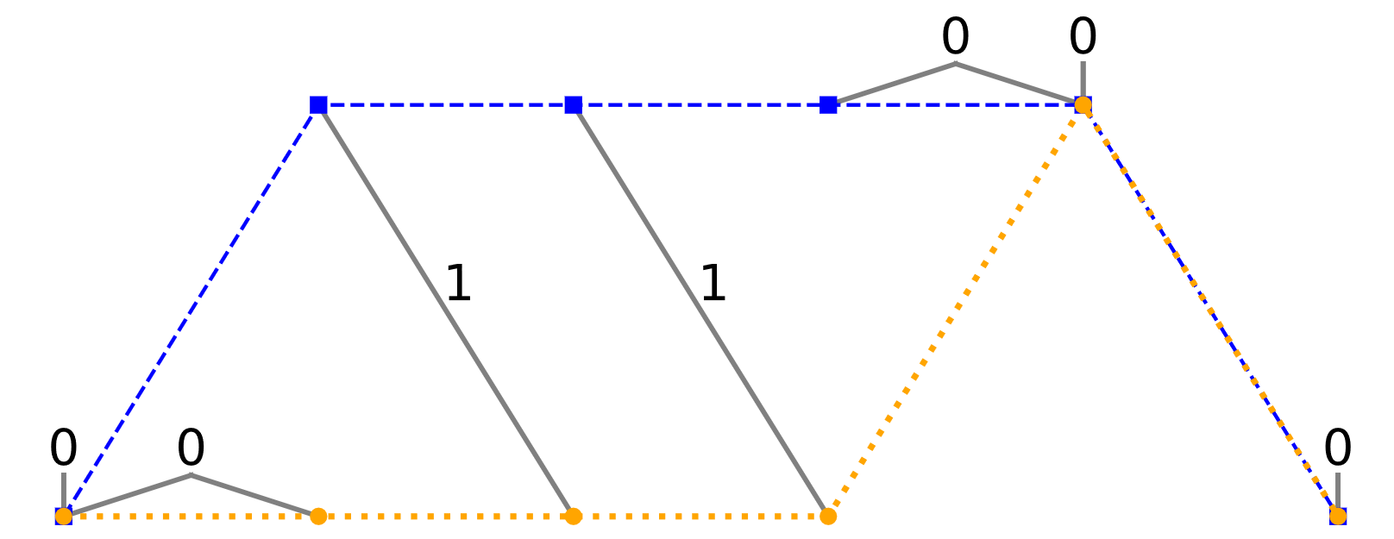
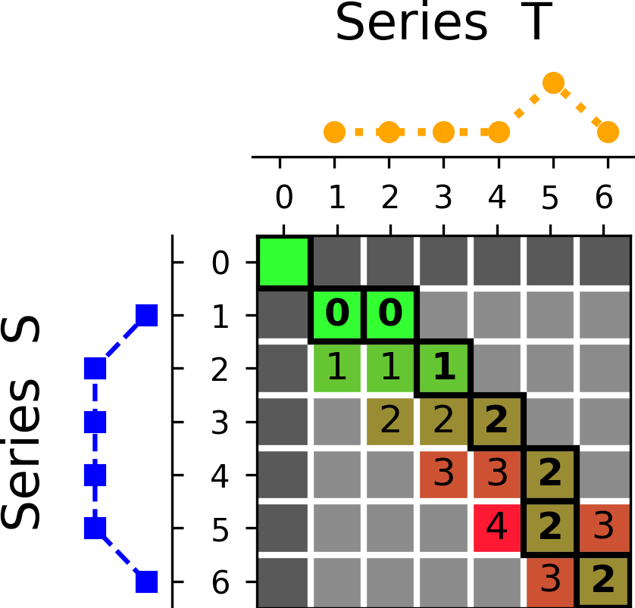
Windowing seeks to control this
Window=1
DTW = 2

Slide 11
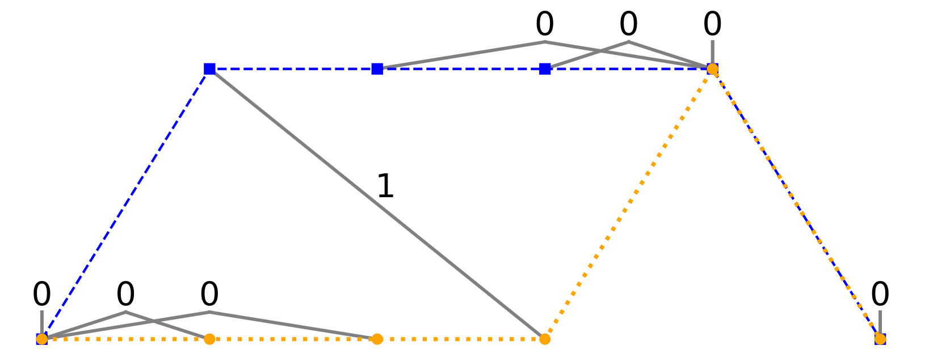
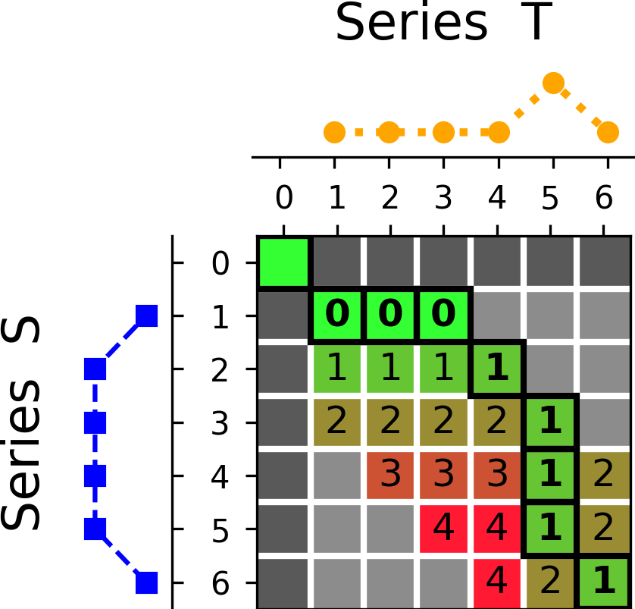
Windowing seeks to control this
Window=2
DTW = 1

Slide 12
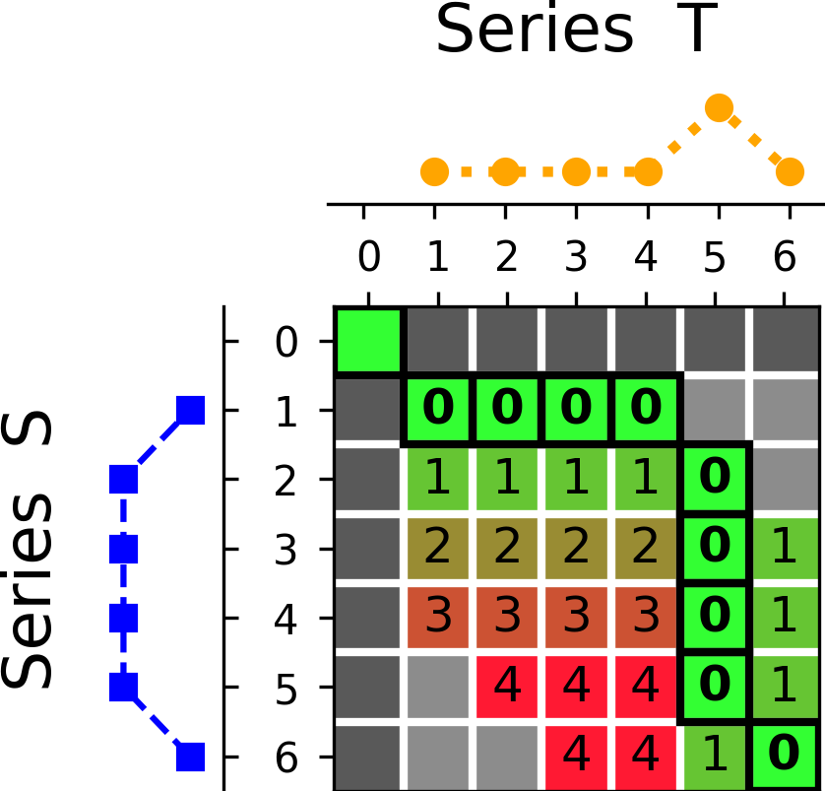
Windowing seeks to control this
Window=3
DTW = 0

Slide 13
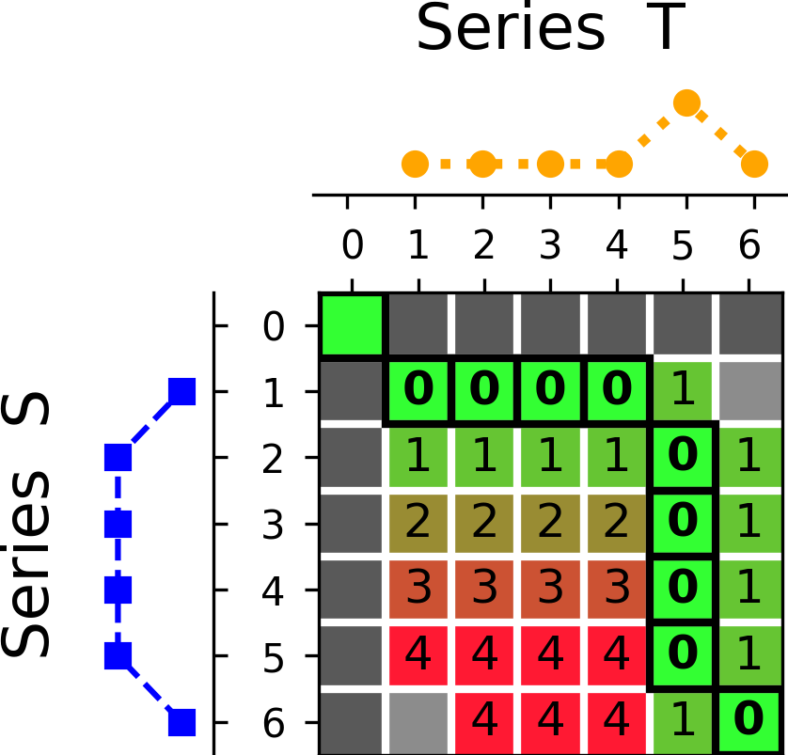
Windowing seeks to control this
Window=4
DTW = 0

Slide 14
Key distance measures: DTW variants
Amerced Dynamic Time Warping
Imposes additive penalty for each warping action
Shape Dynamic Time Warping
Scores each alignment of points using information including slope, wavelet transforms and piecewise approximations of the region around the points
Weighted Dynamic Time Warping
Imposes multiplicative penalty based on the distance from the diagonal

Slide 15
Key distance measures: DTW alternatives
Euclidean
Square root of direct alignment with squared distances
Longest Common Subsequence
Maximum length subsequences of high similarity
Manhattan
Direct alignment
Minkowski
Direct alignment with pointwise distances raised to arbitrary powers
Move-Split-Merge
Very effective edit distance – similar in effect to ADTW with more complex additive penalty for each warping operation
Time Warp Edit
More complex edit distance

Slide 16
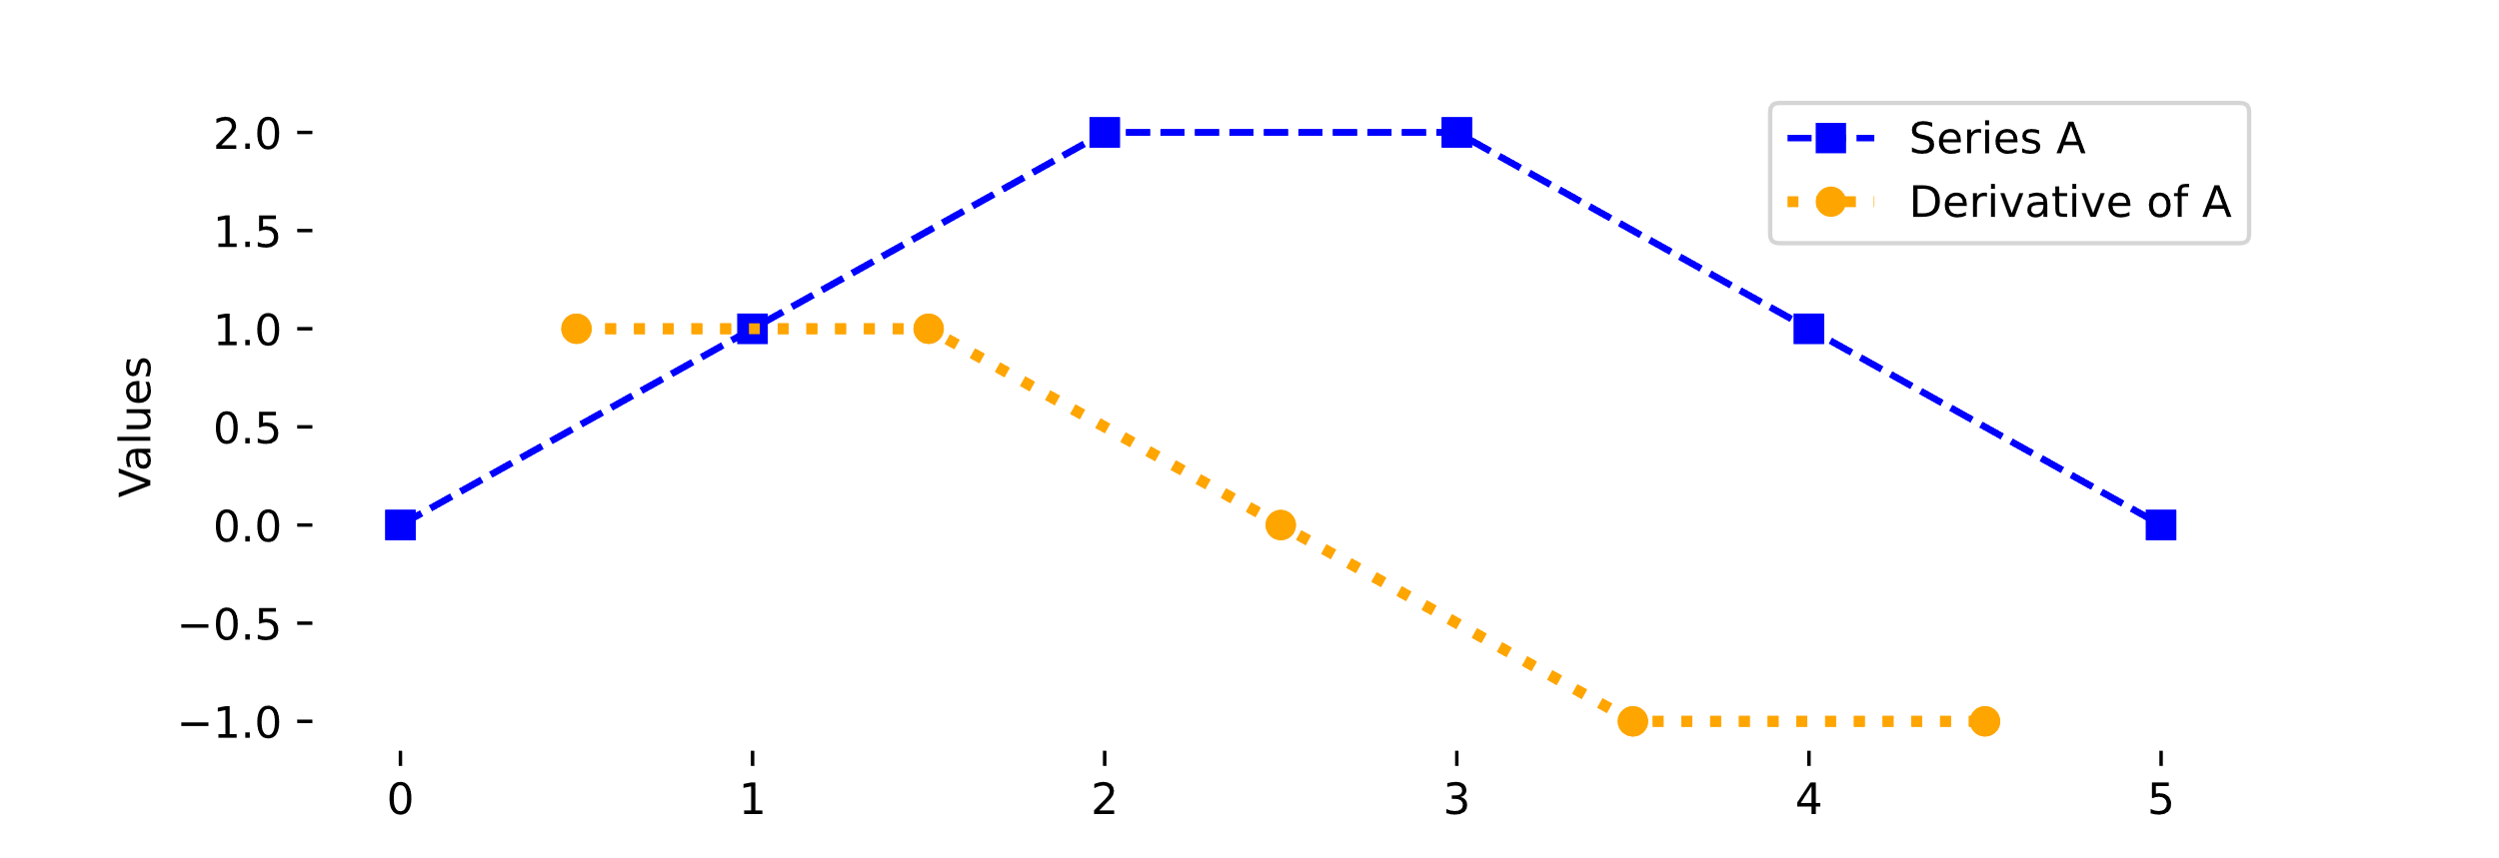
Transforms
Distance measures are often applied to transforms of the raw series

Slide 17
Ensembles

Slide 18
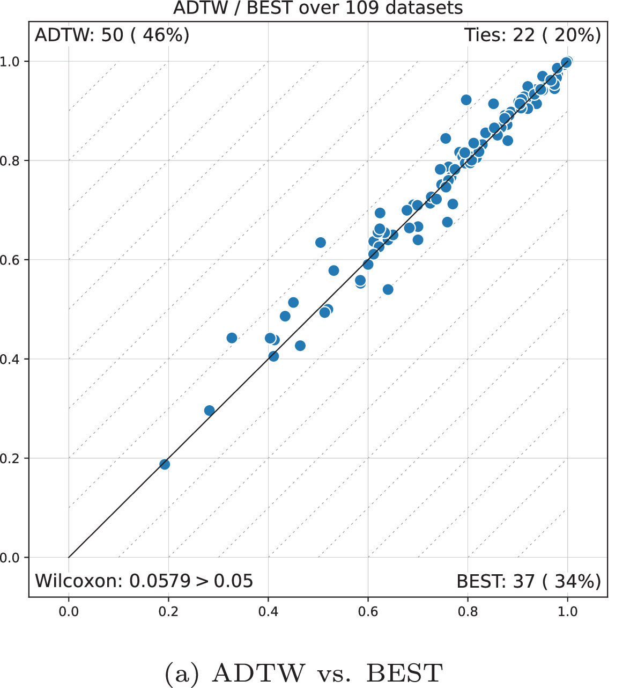
Different measures excel at different tasks

Slide 19
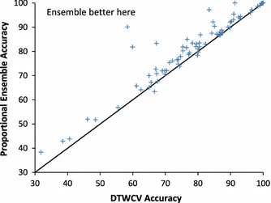
Elastic Ensemble
EE is an ensemble of nearest neighbor classifiers using 11 different distance measures
It significantly outperforms any individual nearest neighbor classifier on the UCR benchmark

Slide 20
Proximity Forest

Slide 21
Proximity Forest
Similarity-based decision trees for time series

Slide 22
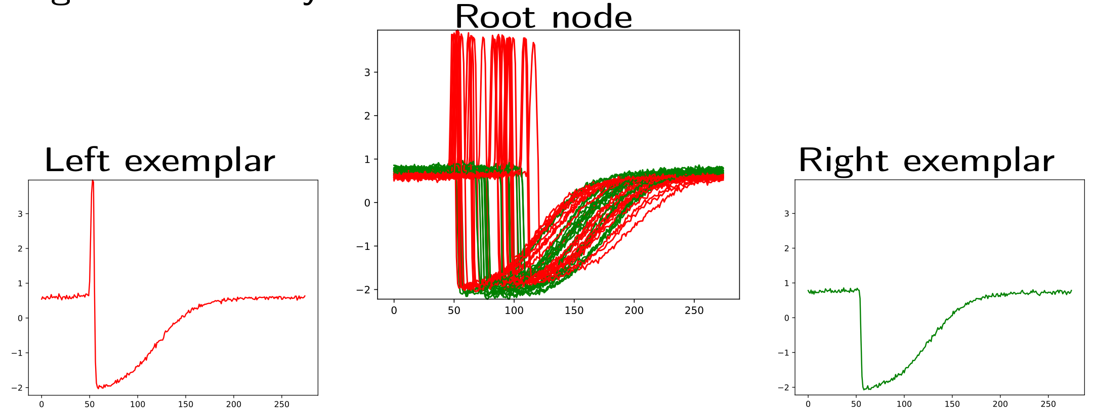

Slide 23
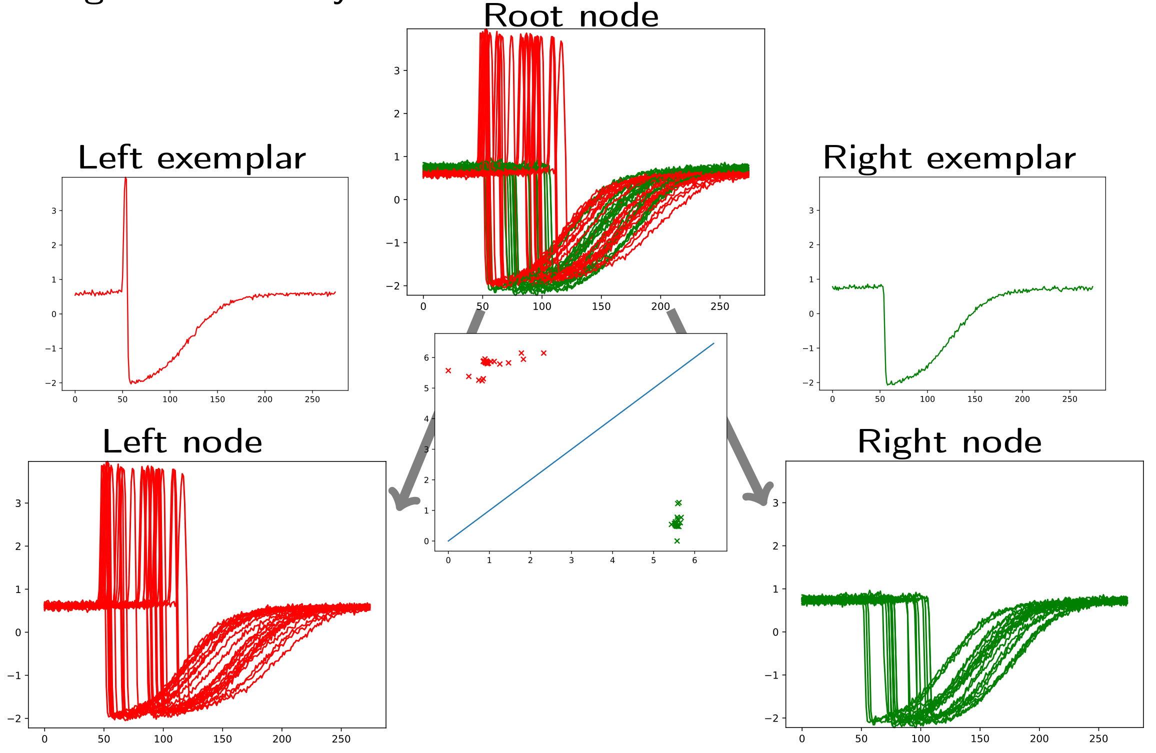

Slide 24
Example code

Slide 25
References
For many distance measures, transforms and the elastic ensemble: Lines, J., & Bagnall, A. (2015). Time series classification with ensembles of elastic distance measures. Data Mining and Knowledge Discovery, 29, 565-592.
ADTW: Herrmann, M., & Webb, G. I. (2023). Amercing: an intuitive and effective constraint for dynamic time warping. Pattern Recognition, 137, 109333.
Proximity Forest: Lucas, B., Shifaz, A., Pelletier, C., O’Neill, L., Zaidi, N., Goethals, B., ... & Webb, G. I. (2019). Proximity forest: an effective and scalable distance-based classifier for time series. Data Mining and Knowledge Discovery, 33(3), 607-635.

